Slide 1

IMAGE
CAPTIONING
Ramez Fawzy Ragheb
Ziad Waleed Waheed

Slide 2
PROJECT
OVERVIEW
Project Title: Image Captioning using Deep Learning
Goal: Automatically generate textual descriptions for images
Architecture Overview:
CNN (VGG16) to extract visual features
RNN (LSTM) to generate text sequence
BLEU Score to evaluate caption quality

Slide 3
os, pickle: File management and saving features
numpy: Numerical operations on arrays
tqdm: Visual progress bar during iteration
tensorflow.keras: Deep learning (VGG16, LSTM, Embedding, etc.)
PIL, matplotlib: Image loading and visualization
nltk: Text cleaning, tokenization, stopwords
LIBRARIES
TOOLS
USED
&

Slide 4
FEATURE EXTRACTION WITH
VGG16
1.
VGG16: PRE-TRAINED ON IMAGENET
2.
MODIFIED: REMOVED FINAL CLASSIFICATION LAYER, USING THE SECOND-TO-LAST LAYER (FC2)
IMAGE PREPROCESSING:
RESIZE TO 224×224
PREPROCESS AND RESHAPE FOR MODEL INPUT
3.
4.
OUTPUT: 4096-DIMENSIONAL FEATURE VECTOR PER IMAGE

Slide 5
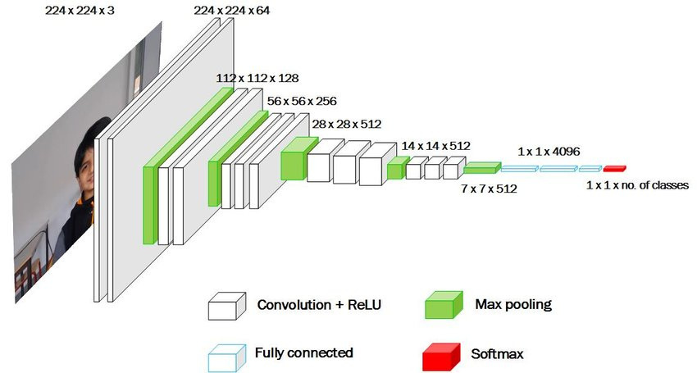
FEATURE EXTRACTION WITH
VGG16

Slide 6
1.
TEXT CLEANING:
Lowercasing
remove special characters
URLs
stopwords
TEXT
2.
TOKENIZATION
PREPROCESSING
Using NLTK's word_tokenize
3.
STRUCTURE CAPTIONS:
Add "startseq" and "endseq" tokens
4.
PURPOSE
Normalize and prepare text for training

Slide 7
DATA
PREPARATION
Image-Caption Mapping: Each image is linked to multiple captions
Tokenizer: Converts words into sequences of integers
Max Length: Longest caption length is calculated
Train/Test Split: 90% training, 10% testing
Data Generator:
Dynamically yields batches
Avoids memory overload
Generates input-output pairs (image + partial caption → next word)

Slide 8
MODEL ARCHITECTURE
(ENCODER–DECODER)
Image Input (Encoder):
Input: 4096-dim feature vector
Dropout → Dense(256, ReLU)
Text Input (Decoder):
Embedding → Dropout → LSTM(256)
Merged Decoder:
Add([image_feature, text_feature])
Dense(256) → Dense(vocab_size, softmax)
Output: Next word in the caption

Slide 9
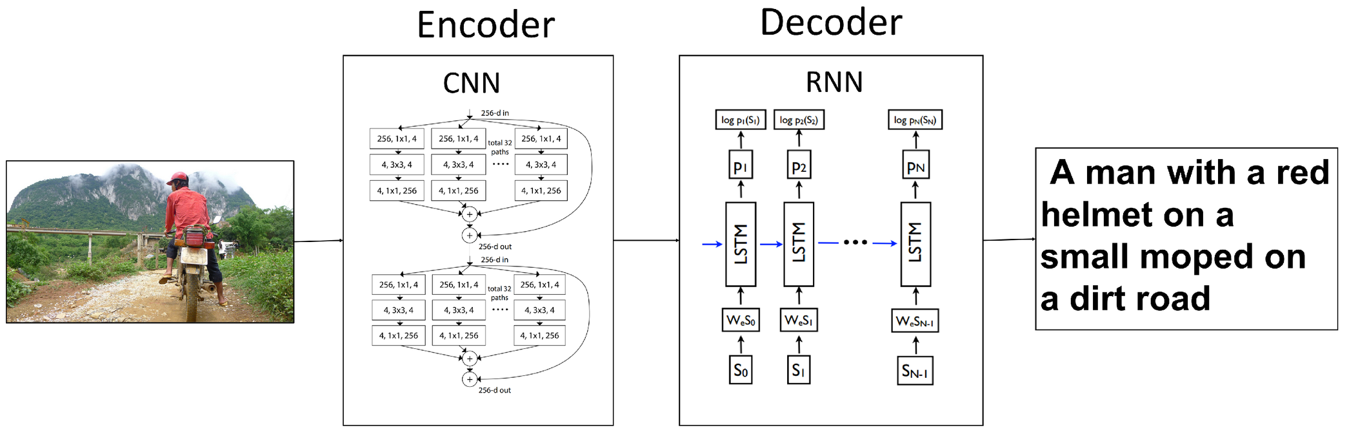
MODEL ARCHITECTURE
(ENCODER–DECODER)

Slide 10

TRAINING PROCESS
Epochs: 30
Batch Size: 32
Optimizer: Adam
Loss Function: Categorical Crossentropy
Training Loop:
For each epoch, a new data generator is created
Trained using model.fit() with steps_per_epoch

Slide 11
CAPTION GENERATION
LOGIC
Start with: "startseq" token
Loop:
Predict next word using current sequence
Append word and continue
Stop if "endseq" is generated or max length is reached
Function: predict_caption() implements this logic

Slide 12
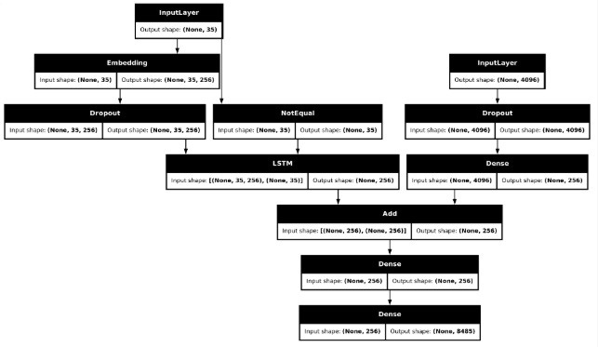
CAPTION GENERATION
LOGIC

Slide 13
EVALUATION WITH
BLEU SCORE
Metric: BLEU (Bilingual Evaluation Understudy)
BLEU-1: Unigram match
BLEU-2: Bigram match
Purpose: Measures how closely predicted captions match real ones
Test Loop:
Compare predictions to ground truth
Calculate and print BLEU scores

Slide 14
DEMO
VISUALIZATION
&
Function: generate_caption(image_name))
Loads and displays an image
Prints all ground-truth captions
Predicts a caption using the trained model
Example:
Input: photo
Output: Visual + actual + predicted captions

Slide 15
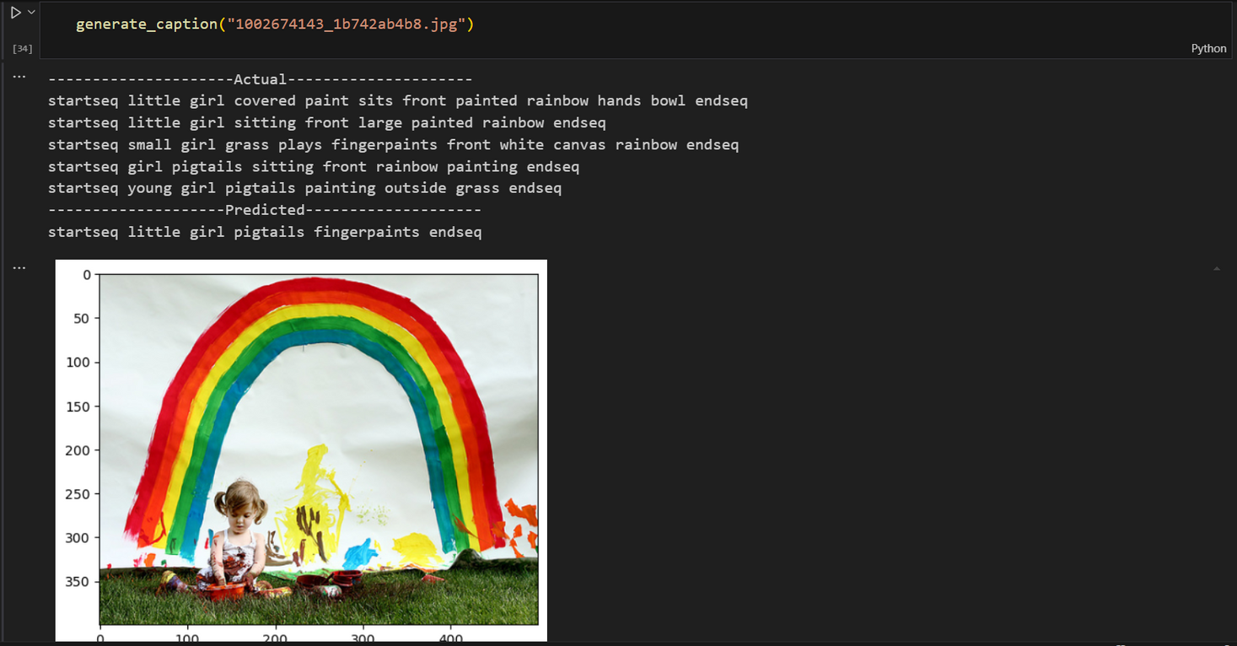
DEMO
VISUALIZATION
&

Slide 16

THANK
YOU!
DR: MOHAMMED

